Slide 1


PROJECT OVERVIEW
BY ANJALI GUPTA
(Data Analyst Intern)

Slide 2
Table of Content
Project 01 - Analyzing Amazon Sales Data
Project 02 – Financial Analytics
Project 03 – Employee Attrition Analysis

Slide 3

01- AMAZON SALES ANALYSIS

Slide 4

PROBLEM STATEMENT
Amazon is an e-commerce company, and its sales management team has gained importance due to increasing competition and the need for improved methods of distribution to reduce costs and increase profits. Sales management is now considered the most important function in a commercial and business enterprise.

Slide 5

DETAILS OF DATA
Performed ETL (Extract-Transform-Load) on Amazon dataset to find Sales Trend : Month-wise, Year-wise, Yearly Month-wise.
Found KPIs and factors to show the meaningful relationships between attributes.
Recognizing sales management as the cornerstone of success in the commercial and business landscape.
Showcasing the power of visual representation through a dynamic Power BI dashboard.
Utilizing a diverse set of visualizations, including clustered column charts, line charts, tree maps, filled maps, slicers, and cards, to present a comprehensive view of sales data.
Unearthing insights into monthly and yearly sales trends, unit sales correlations, regional profit dynamics, and order priority analysis.
Enabling strategic decision-making in sales strategies, inventory management, and resource allocation.

Slide 6
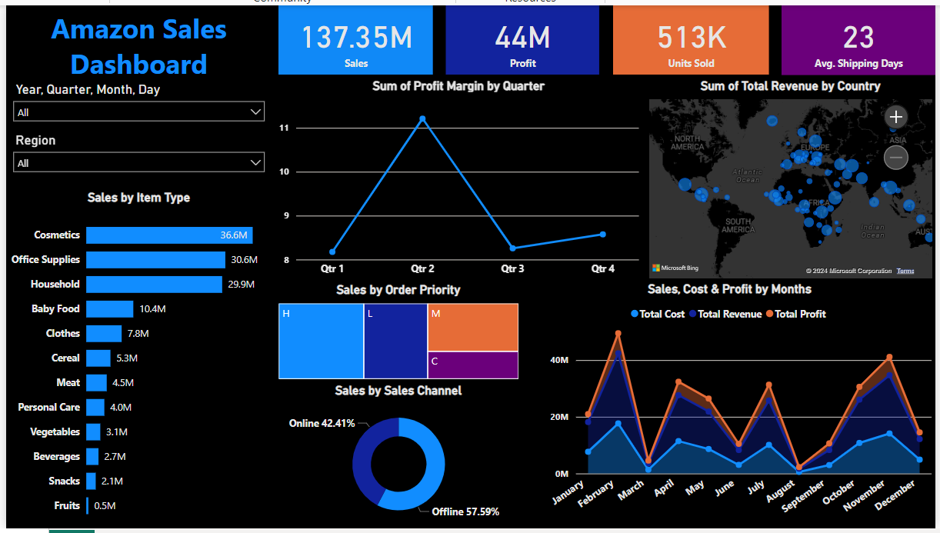
DASHBOARD SNIPPET

Slide 7
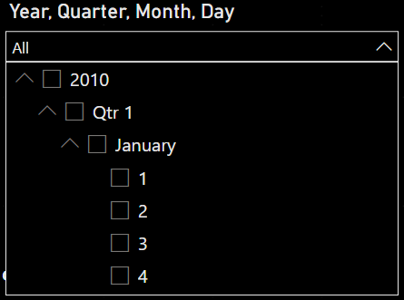
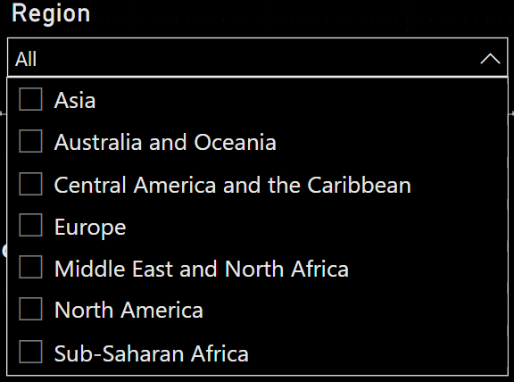
FILTERS IN DASHBOARD
Filter by
Year> Quarter> Month> Day
Filter by
Regions Amazon is catering

Slide 8

INSIGHTS FROM THE ANALYSIS
Monthly Sales Trends:
Highest sales occurs in February with $24,740,517.77.
Lowest sales occurs in August with $1,128,164.91.
Yearly Sales Trends:
The Highest sales in 2012 with $31,898,644.52.
The Lowest sales in 2015 with $12,427,982.86.
Total Revenue and Costs:
Total Revenue generated from 2010-2017 is $137.35 Million
Total Cost is incurred is $93.18 million
Total Unit Price is $27.68k
Total Unit Cost is $19.10k
Order Priority Analysis:
Order Priority 'H' has sold the most number of units i.e 154,212
Order Priority 'M' has sold the least number of units i.e 94,832
Region-wise Profit Analysis:
Sub-Saharan Africa has generated highest profit in offline sales (approx. $7.8 M) and is the second-highest in online sales.
Europe has the highest profit in online sales (approx. $5.5 M) and the second-highest in offline sales.
Revenue by Item type :
Household Items have the highest Total Revenue in Offline sales approx. $29.7 M
Cosmetics Item have the highest Total Revenue in Online sales approx. $18.3 M

Slide 9
02- Financial Analytics

Slide 10
Problem Statement
It is crucial for a business to analyze the competition in order to survive. You have been assigned the task of analyzing the competition to help the management achieve better results. The dataset contains information about the market capitalization of the top 500 companies in India, including Serial Number, Company Name, Market Capitalization in Crores, Quarterly Sales in Crores, and various other attributes. Your goal is to identify key metrics and factors and to illustrate meaningful relationships between these attributes.

Slide 11
Introduction
The Financial Analysis Dashboard provides a detailed look at the financial health and market positioning of leading companies across various industries. By examining key metrics such as market capitalization and quarterly sales, this analysis offers valuable insights into the performance and dominance of major players in the market. The dashboard is designed to highlight critical financial data, enabling stakeholders to make informed decisions based on comprehensive and up-to-date information. This analysis covers a wide range of industries, emphasizing the contributions and standings of top companies, and underscores the significant trends and disparities within the market. Through visual representations and detailed metrics, the dashboard facilitates a clear understanding of the financial landscape, making it an essential tool for investors, analysts, and business strategists.

Slide 12
Approach
Data Cleaning: Data cleaning ensures that the data is accurate, consistent, and usable. This includes handling missing values, removing duplicates, and other manipulations using MS Excel.
Data Modeling: Data modeling involves structuring the data to extract meaningful insights, such as defining metrics, aggregation, creating new measures, and more.
Data Visualization: Data visualization helps in interpreting the data and identifying trends and patterns. We utilized Power BI to visualize the distribution of market capitalization and quarterly sales. The financial analysis dashboard provides a comprehensive overview of market capitalization and quarterly sales across various industries.

Slide 13
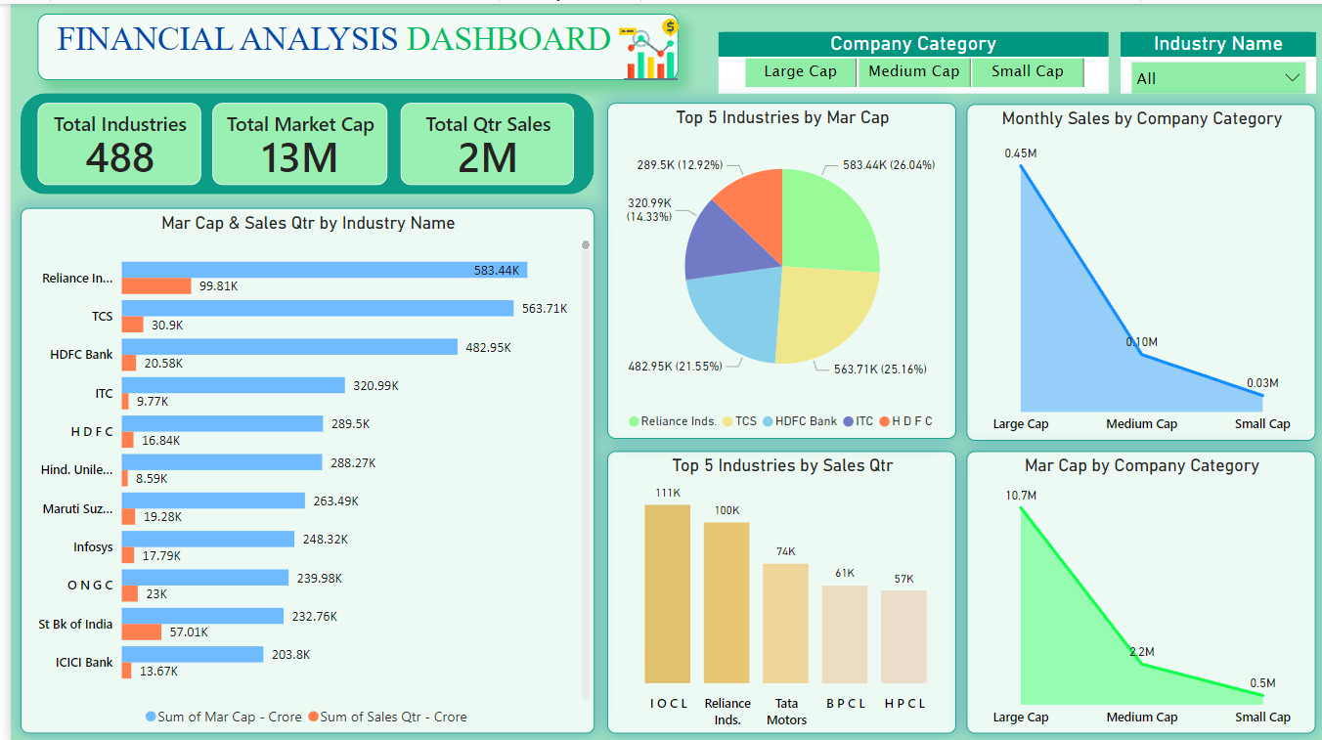
Dashboard

Slide 14
Visual Insights
Key Metrics:
Total Industries: 488
Total Market Cap: 13 million crore
Total Quarterly Sales: 2 million crore
Top Companies by Market Capitalization:
Reliance Industries: Market Cap - 583,436.7 crore; Quarterly Sales - 99,810 crore
TCS: Market Cap - 563,709.8 crore; Quarterly Sales - 30,904 crore
HDFC Bank: Market Cap - 482,953.6 crore; Quarterly Sales - 20,581.27 crore
ITC: Market Cap - 320,985.3 crore; Quarterly Sales - 9,772.02 crore 5. HDFC: Market Cap - 289,497.4 crore; Quarterly Sales - 16,840.51 crores

Slide 15
Visual Insights
Market Cap&Quarterly Sales by Industry
Reliance Industries stands out with the highest market cap and quarterly sales.
TCS and HDFC Bank also have substantial market caps, though their sales are comparatively lower.
A significant gap in market cap is observed between the top companies and those ranked lower.
Market Cap Distribution
The pie chart illustrates the distribution of market caps among the top companies, with Reliance Industries and TCS holding the largest shares.
Monthly Sales by Company Category
Large Cap companies dominate monthly sales, with a steep drop-off for Medium Cap and Small Cap companies.
Market Cap by Company Category
Similarly, Large Cap companies hold the majority of the market, with Medium Cap and small-cap companies holding much smaller portions

Slide 16
Conclusion
Dominance of Large Cap Companies: Large Cap companies, particularly Reliance Industries, significantly influence the market with their substantial market cap and sales figures.
Disparity in Market Cap and Sales: A notable disparity exists between the market cap and sales of the top companies, indicating that high market cap does not always correlate with higher sales.
Leading Industries: The oil and gas sector (e.g., IOCL, BPCL) is prominent among the top industries by quarterly sales, underscoring its critical role in the economy.
Concentration of Market Cap: Marketcap is heavily concentrated in a few large companies, suggesting a market that is less diversified
This analysis highlights the financial strength and market positioning of leading companies, providing valuable insights for investors and stakeholders.

Slide 17
03- Employee Attrition

Slide 18
Problem Statement
The XYZ company, which was established a few years ago, has been experiencing a high attrition rate of around 15% for the past couple of years. This has had a major impact on the company in various ways. To address this issue, the company has enlisted the help of an HR analytics consultancy to analyze the available data and understand why employees are leaving. As the HR analyst for this project, my role involves creating a dashboard that will assist the organization in making data-driven decisions.

Slide 19
Introduction
Employee attrition, also known as turnover, refers to when employees leave an organization, leading to increased costs and disruptions. Analyzing attrition data helps to identify patterns and trends, allowing organizations to implement strategies to retain talent. This involves examining factors such as demographics, job roles, tenure, job satisfaction, and compensation to improve overall employee satisfaction and retention.

Slide 20
Approach
Data Cleaning: Data cleaning ensures that the data is accurate, consistent, and usable. This includes handling missing values, removing duplicates, and other manipulations using MS Excel.
Data Modeling: Data modeling involves structuring the data to extract meaningful insights, such as defining metrics, aggregation, creating new measures, and more.
Data Visualization: Data visualization helps in interpreting the data and identifying trends and patterns. We utilized Power BI to visualize the distribution of market capitalization and quarterly sales. The financial analysis dashboard provides a comprehensive overview of market capitalization and quarterly sales across various industries.

Slide 21
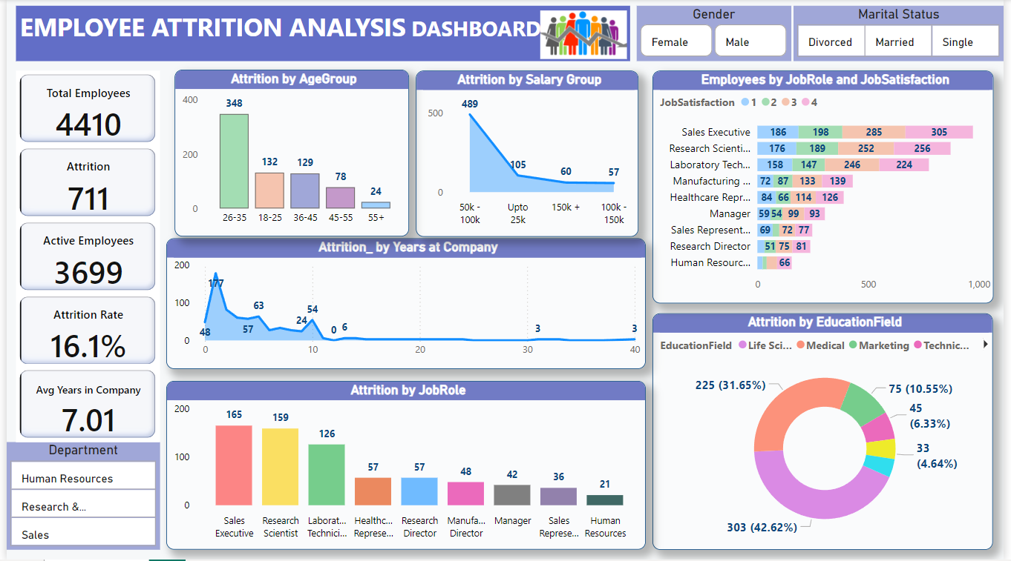
Dashboard

Slide 22
Visual Insights
Key Metrics
Total Employees: 4410
Total Attrition: 711 employees
Active Employees: 3699
Attrition Rate:16.1% Average Years in Company: 7.01 year
Key Insights
1. Attrition by Age Group:
The highest attrition occurs in the age group of 26-35 years, with 348 employees.
Other significant attrition groups are 18-25 (132), 36-45 (129), 46-55 (78), and 55+ (24).
2. Attrition by Salary Group:
The salary group 50k-100k experiences the highest attrition with 489 employees.
Other salary groups include Upto 25k (105),150k+ (60), and 100k-150k (57).

Slide 23
Visual Insights
3. Attrition by Years at Company:
Highest attrition happens within the first year (147 employees).
Attrition significantly drops after the first year, with minor peaks at later years.
4. Attrition by Job Role:
Sales Executives have the highest attrition (165 employees), followed by Research Scientists(159) and Laboratory Technicians(126).
Other roles include Healthcare Representatives, Research Directors, Managers, Sales Representatives, and Human Resources.
5. Employees by Job Role and Job Satisfaction:
The job satisfaction levels range from 1 to 4.
Sales Executives and Research Scientists have varied job satisfaction levels, with noticeable attrition at lower satisfaction levels.
6. Attrition by Education Field:
Life Sciences have the highest attrition with 303 employees, followed by Medical (225) and Marketing (75).
Other fields include Technical Degrees, Human Resources, and Other.

Slide 24
Conclusion
High-Risk Groups:
Areas for Improvement:
Employees aged 26-35 years.
Employees with 1 year of tenure.
Sales Executives and Research Scientists.
Employees in the salary range of 50k -100k.
Employees with Life Sciences and Medical educational backgrounds.
Focus on retention strategies for employees in their first year.
Increase job satisfaction for high-attrition roles like Sales Executives and Research Scientists.
Explore reasons behind high attrition in the 50k-100k salary range and address them.
Tailored retention programs for employees aged 26-35 years
According to me, By addressing these key areas, the organization can work towards reducing the overall attrition rate and improving employee retention.

Slide 25



